Slide 1


Character and String
Nazrin Dolkhanova Sultanli
Programming and Computer Applications – 1

Slide 2



Agenda
Character
Character arithmetic
Character Functions
String – Conversion Functions
Read and Print Characters
String
Standard Input/Output Library Functions
String-Manipulation and Comparison Functions of the String- Handling Library
Search Functions of the String-Handling Library
Memory Functions of the String-Handling Library

Slide 3

Topic eight
Character and String

Slide 4
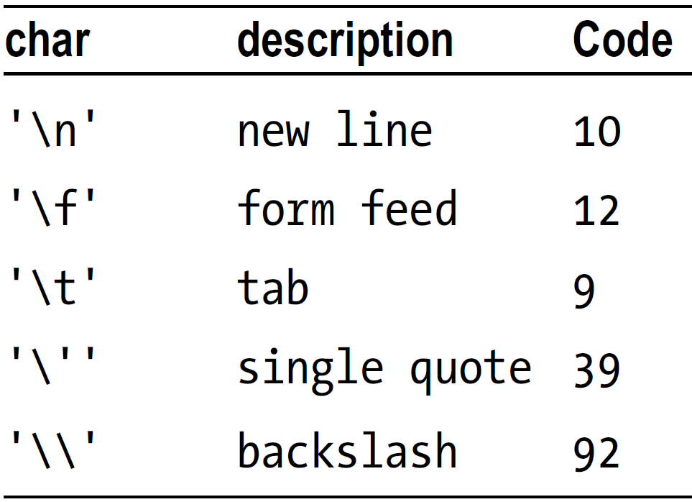
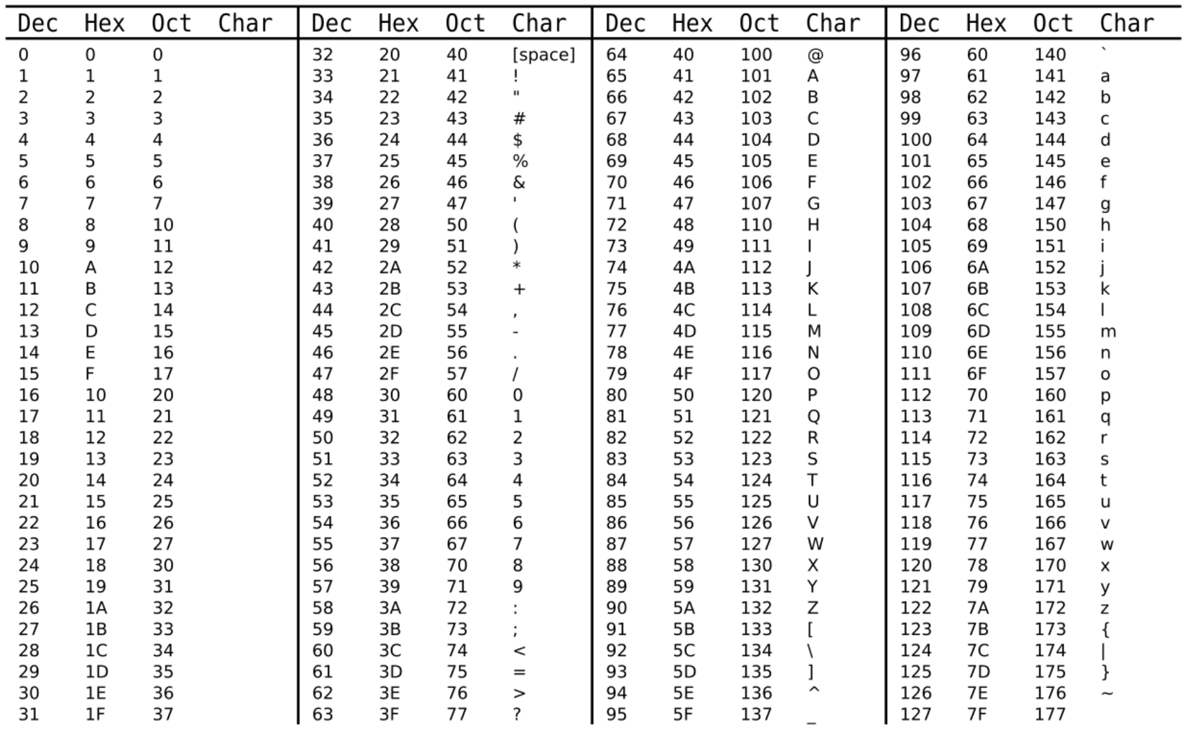
8.1 Character
A character constant is a single character enclosed in single quotes such as ‘A’, ‘+’ and ‘5’. Some characters cannot be represented like this because we cannot type them. Others play a special role in C (e.g. ', \). For these, we use an escape sequence enclosed in single quotes. Some examples are shown in the following table:
Character constant has an integer value associated with it—the numeric code of the character represented. Thus, the integer value of 'T' is 84 since the ASCII code for T is 84. The integer value of '\\' is 92 since the ASCII code for \ is 92. And the integer value of '\n' is 10 since the ASCII code for the newline character is 10.
We could print the character value of a character variable using %c in printf. And we could print the integer value of a character variable using %d. For instance,
ch = 'T';
printf("Mr. %c\n", ch);
printf("Mr. %d\n", ch);
will print
Mr. T
Mr. 84

Slide 5
8.2 Character arithmetic
C allows us to use variables and constants of type char directly in arithmetic expressions. When we do, it uses the integer value of the character. For example, the statement
int n = 'A' + 3;
assigns 68 to n since the code for 'A' is 65.
Similarly, we can assign an integer value to a char variable. For example,
char ch = 68;
In this case, “the character whose code is 68” is assigned to ch; this character is 'D'.
For a more useful example, consider the following:
int d = '5' - '0';
The integer 5 is assigned to d since the code for '5' is 53 and the code for '0' is 48.
In general, if ch contains a digit character ('0' to '9'), we can obtain the integer value of the digit with the statement
d = ch - '0’;
ASCII codes for 'A' to 'Z' range from 65 to 90 and the codes for 'a' to 'z' range from 97 to 122. So, the difference between the codes for the two cases of a letter is always 32; for example,
'r' - 'R' = 114 – 82 = 32
Hence we can convert a letter from uppercase to lowercase by adding 32 to the uppercase code. This can be done with
ch = ch + 32;
ch = ch + 'a' - 'A';

Slide 6
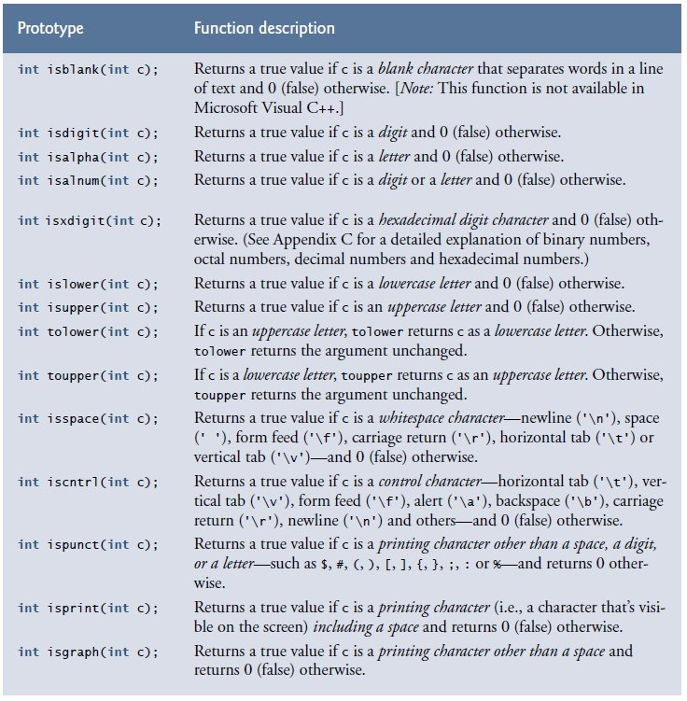
8.3 Character Functions
#include <ctype.h> should be used.

Slide 7
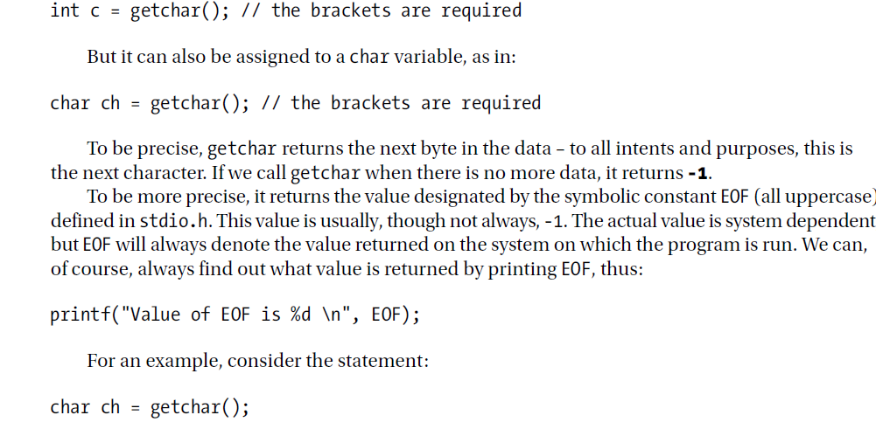
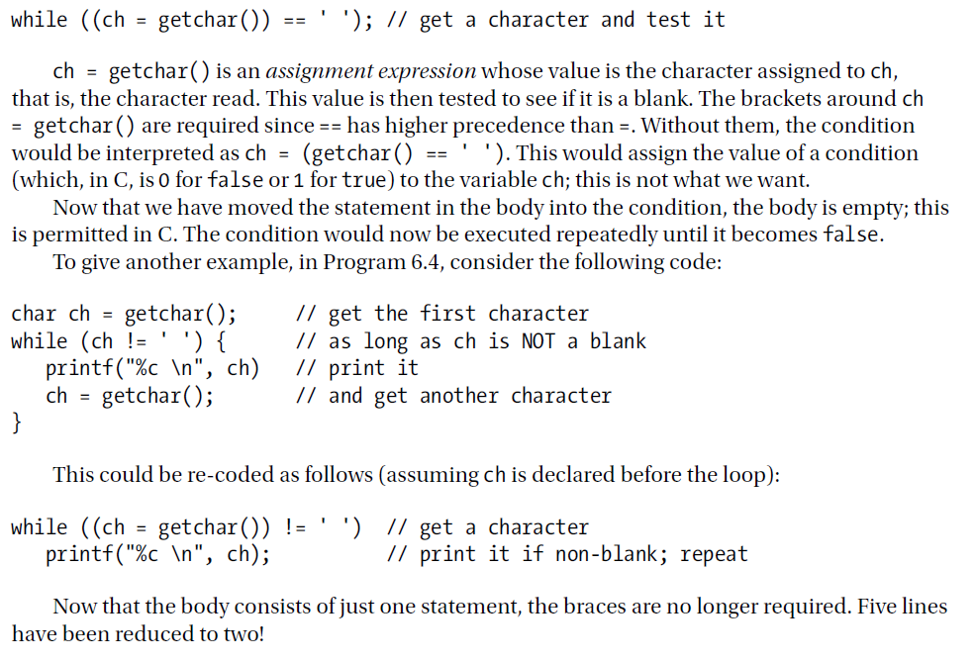
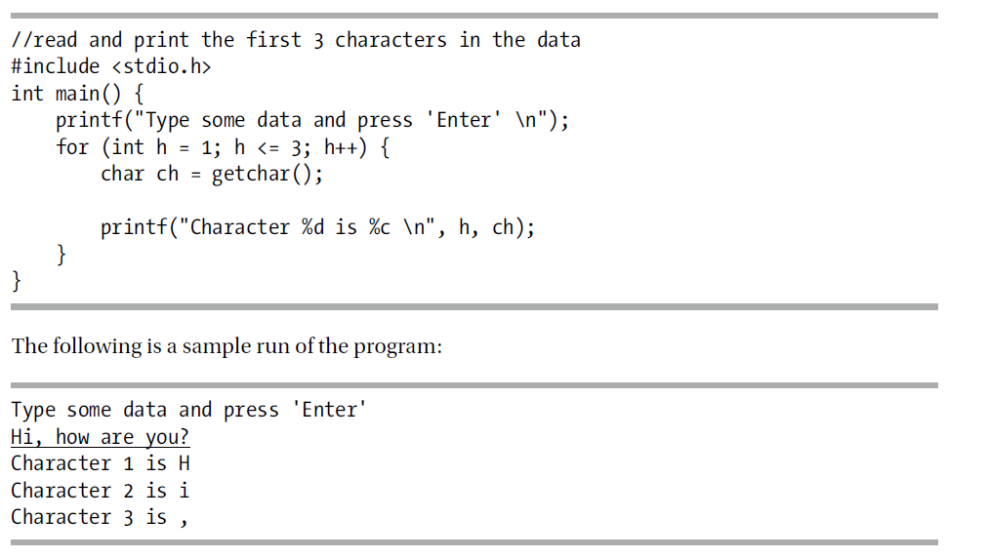
8.4 Read and Print Characters
A getchar() gets a single character (unsigned char) from the stdin.(#include stdin.h).
int getchar (void);
getchar() vs getc() function:
A getchar() reads a single character from standard input, while a getc() reads a single character from any input stream.
The putchar(int char) method in C is used to write a character, of unsigned char type, to stdout. This character is passed as the parameter to this method.
int putchar(int char)
scanf("%c", &ch);
int c = getchar();
char ch = getchar();
printf("%c \n", ch);
putchar(ch);

Slide 8
8.5 String
A string is a series of characters treated as a single unit. A string may include letters, digits and various special characters such as +, -, *, / and $.
String in C is an array of characters ending with the null character ('\0'). A string is accessed via a pointer to the first character in the string. The value of a string is the address of its first character. Thus, in C, it’s appropriate to say that a string is a pointer— in fact, a pointer to the string’s first character. This is just like arrays, because strings are simply arrays of characters.
A character array or a variable of type char * can be initialized with a string in a definition.
The definitions:
char color[] = "blue";
const char *colorPtr = "blue";
each initialize a variable to the string "blue". The first definition creates a 5-element array color containing the characters 'b', 'l', 'u', 'e' and '\0'. The second definition creates pointer variable colorPtr that points to the string "blue" somewhere in read-only memory.
The preceding array definition could also have been written
char color[] = { 'b', 'l', 'u', 'e', '\0’ };

Slide 9
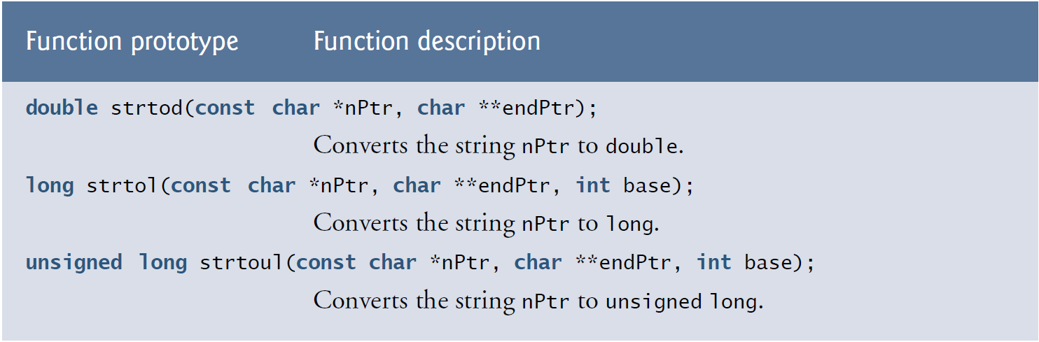
8.6 String – Conversion Functions

Slide 10
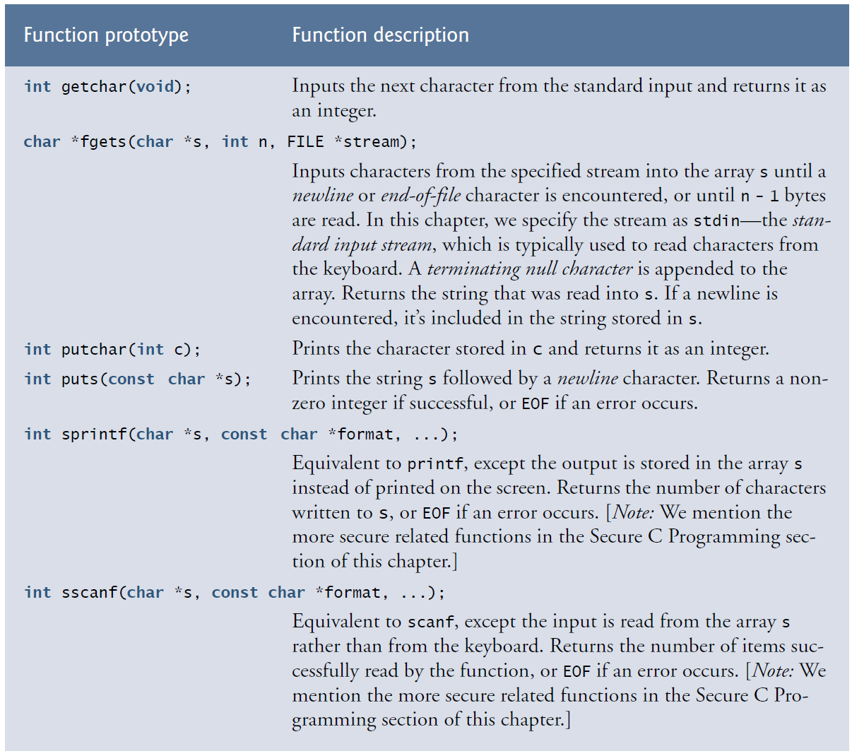
8.7 Standard Input/Output Library Functions

Slide 11
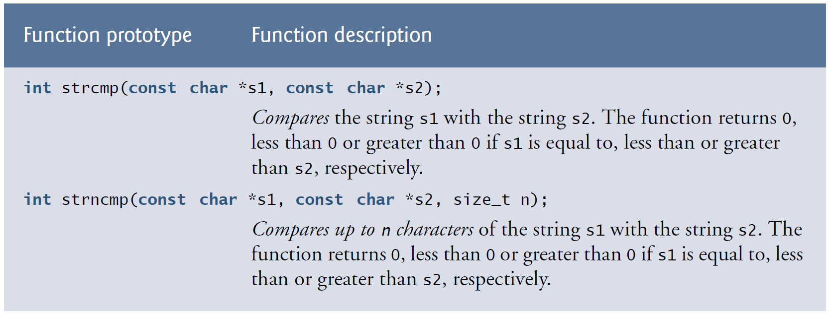
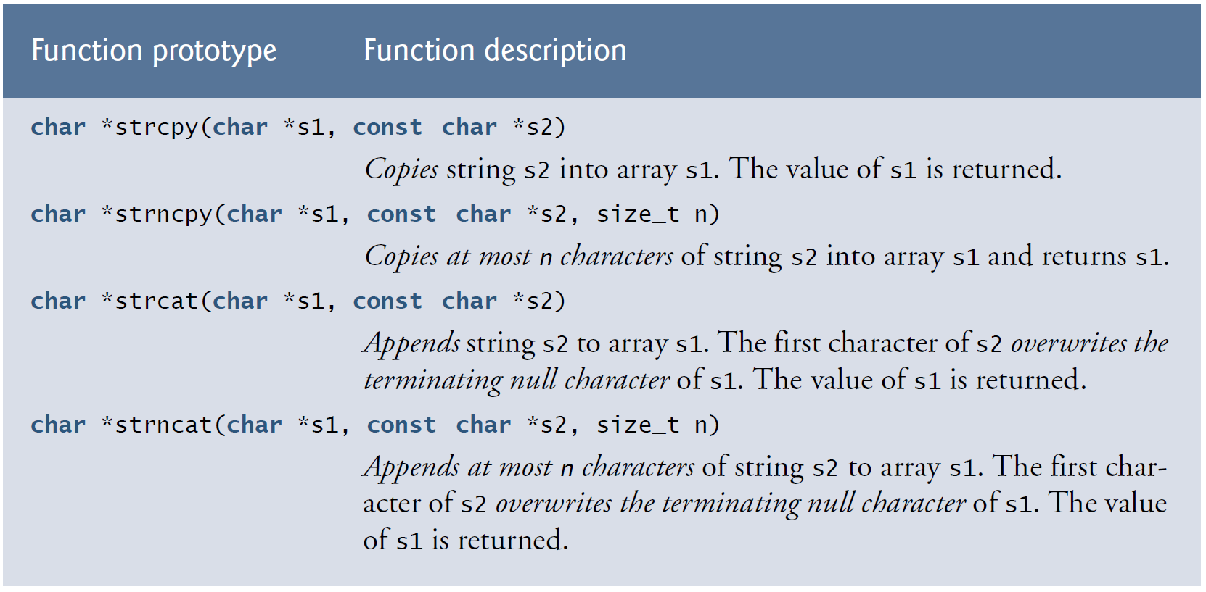
8.8 String-Manipulation and Comparison Function of the String- Handling Library

Slide 12
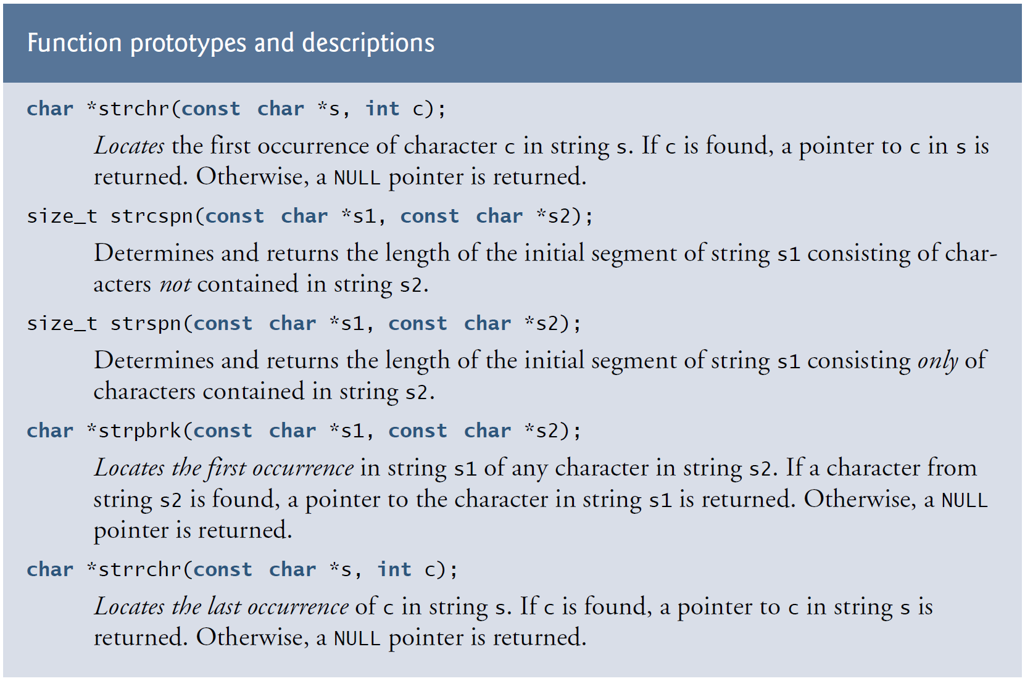
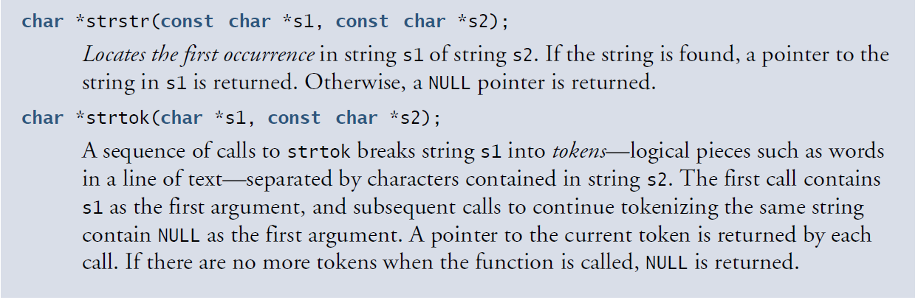
8.9 Search Functions of the String-Handling Library

Slide 13
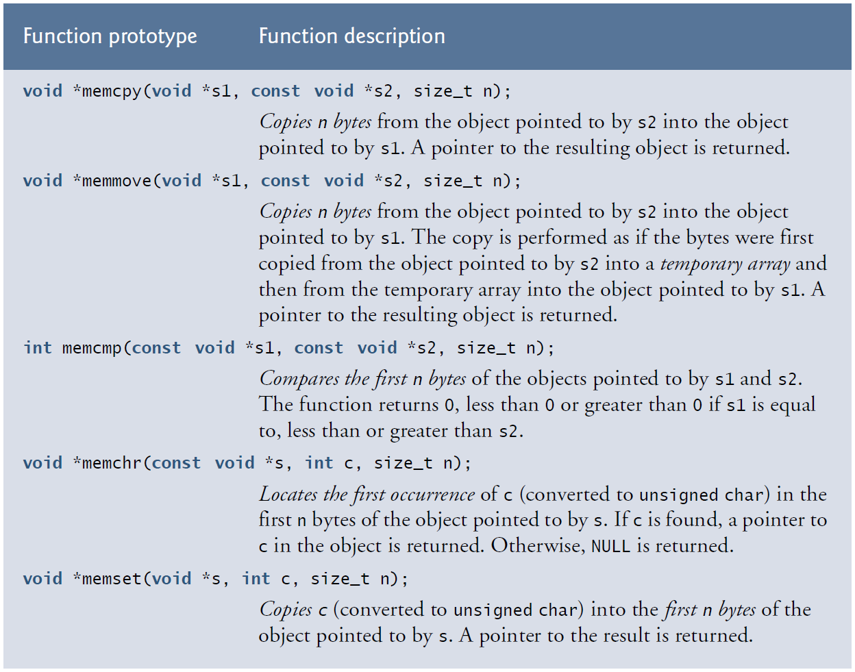
8.10 Memory Functions of the String-Handling Library

Slide 14

References
Each Reference is indicated on the footer on each slide.
Books:
The_C_Programming_Language_(2nd_Edition_Ritchie_Kernighan)
Learn to Program with C_ Learn to Program using the Popular C Programming Language (Noel Kalicharan)
C How to Program, 8th edition, Paul Deitel and Harvey Deitel, Pearson, 2016.

Slide 15


Thank You
Nazrin Dolkhanova Sultanli
Nazrin.Sultanli.Dolkhanova@bhos.edu.az
Baku Higher Oil School

